Slide 1

FLIGHT PRICE PREDICTION
By: Deepak kr. Singh

Slide 2

Overview:
In this particular presentation we will be focusing on:
How to analyze the dataset of Flight Price Prediction.
What are the EDA steps in cleaning the dataset.
Overall analysis on the problem.
Model building from cleaned dataset.
Predicting Flight Price for saved best model.

Slide 3
Understanding Problem statement
Anyone who has booked a flight ticket knows how unexpectedly the prices vary. The cheapest available ticket on a given flight gets more and less expensive over time. This usually happens as an attempt to maximize revenue based on –
1. Time of purchase patterns (making sure last-minute purchases are expensive)
2. Keeping the flight as full as they want it (raising prices on a flight which is filling up in order to reduce sales and hold back inventory for those expensive last-minute expensive purchases)
So, you have to work on a project where you collect data of flight fares with other features and work to make a model to predict fares of flights.

Slide 4
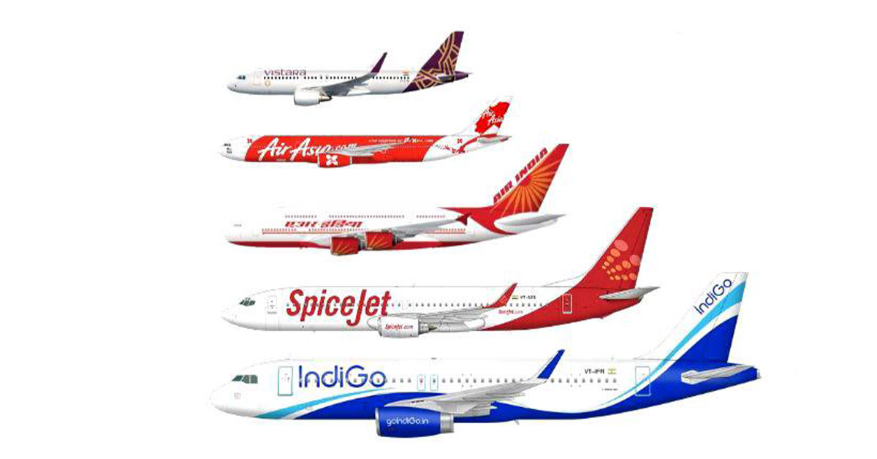
Problem Understanding:
Flight prices are something unpredictable. It’s more than likely that we spent hours on the internet researching flight deals, trying to figure an airfare pricing system that seems completely random every day. Flight price appears to fluctuate without reason and longer flights aren’t always more expensive than shorter ones.
But now the question is how to know proper Flight price, for that I have built a Machine learning model which can predict the Flight price. Using various features like Airline, Source, Destination, Arrival time, Departure time, Stops, Travelling date and the Price for the same travel. So using all these previously known information and analysing the data I have achieved a good model, good accuracy.

Slide 5
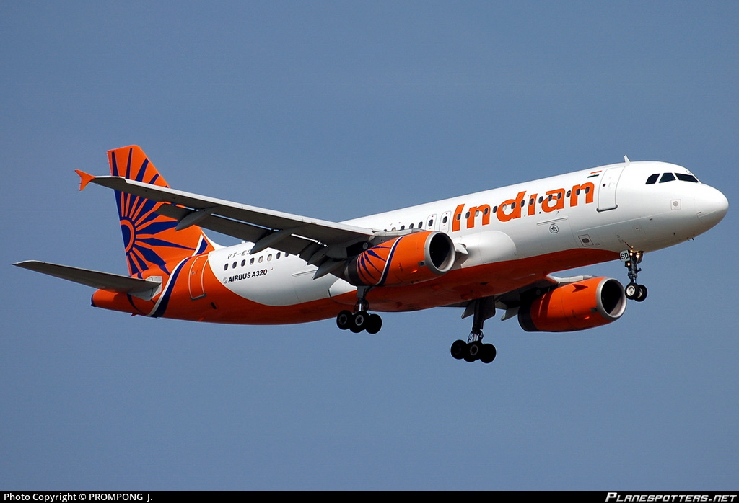
Flight Price Prediction:
The number of people using flights has increased significantly. It is difficult for airlines to maintain prices since prices change dynamically due to different conditions. That’s why we will try to use machine learning to solve this problem.
Nowadays, airline corporations are using complex strategies and methods to assign airfare prices in a dynamic fashion. These strategies are taking into consideration several financial, marketing, commercial and social factors are closely connected with the ultimate airfare prices.

Slide 6
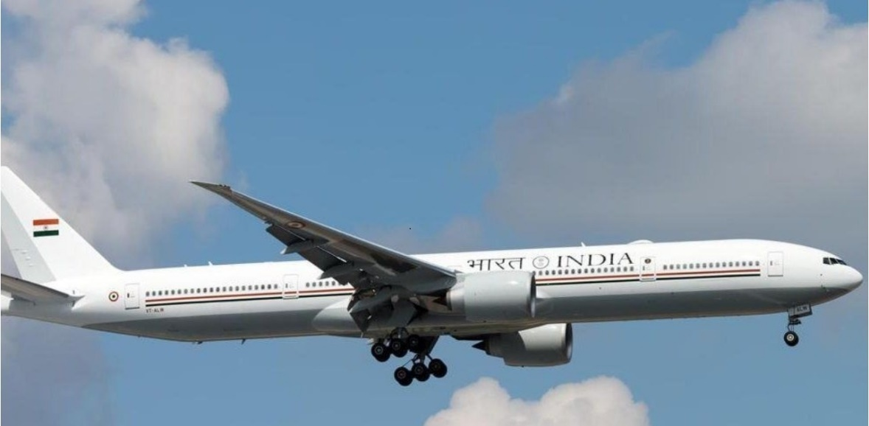
Importance of Flight Price Prediction:
As domestic air travel is getting more and more popular these days in India with various air ticket booking channels coming up online, travelers are trying to understand how these airline companies make decisions regarding ticket prices over time.
The majority of these systems are utilizing the modern computerized system known as Machine Learning. The model guesses airfare well in advance from the known information
It is hard for the client to buy an air ticket at the most reduced cost. For this few procedures are explored to determine time and date to grab air tickets with minimum fare rate.

Slide 7
Exploratory Data Analysis:
As a first step I have scrapped the required data using selenium from makemytrip.com website.
And I have imported required libraries and I have imported the dataset which was in csv format.
Then I did all the statistical analysis like checking shape, nunique, value counts
While checking for null values I found there was a row full of null values in the dataset and I dropped that row as it will not help our analysis.
I have also droped Unnamed:0 column as I found it was the index column of csv
Next as a part of feature extraction I converted the data types of date time columns and I have extracted useful information from the raw dataset. Thinking that this data will help us more than raw data.

Slide 8
Data Cleaning and model building Steps:
Data has been scrapped from makemytrip website so we have to clean it for our convenience.
In my datasets I found there is no null values, outliers and also skewness.
To encode the categorical columns I have use Label Encoding.
Use of Pearson’s correlation coefficient to check the correlation between dependent and independent features.
Also I have used standardization. Then followed by model building with all regression algorithms.
I have used dist plot to check the skewness in numerical columns.
I have used bar plot for each of categorical feature that shows the relation with the median flight price for all the sub categories in each categorical feature.
And also for continuous numerical variables I have used strip to show the relationship between continuous numerical variable and target variable.
I found that there is a linear relationship between continuous numerical variable and Flight Price.

Slide 9
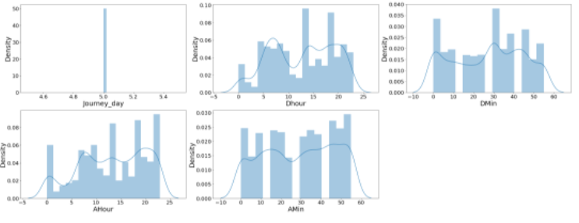
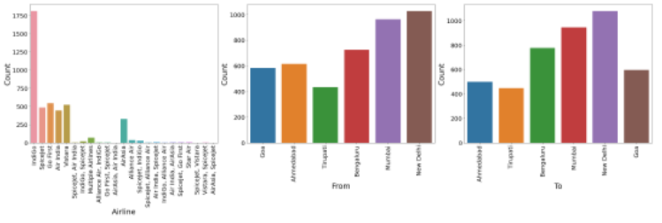
Visualization
Univariate analysis

Slide 10
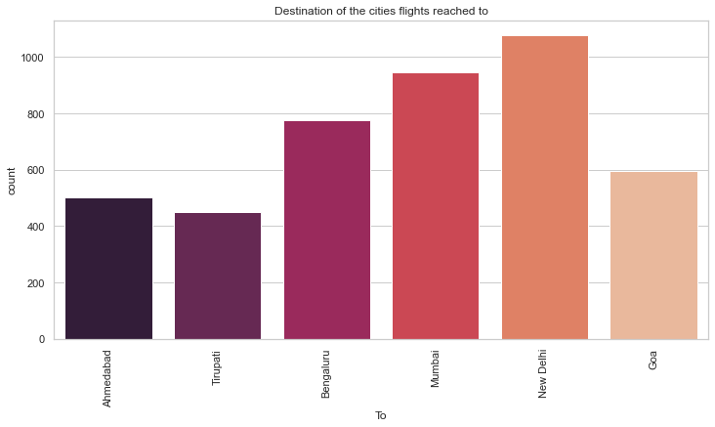
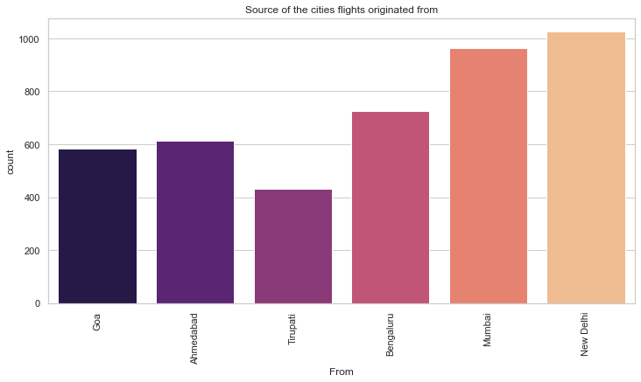
Flights per day Source/ Destination city:

Slide 11
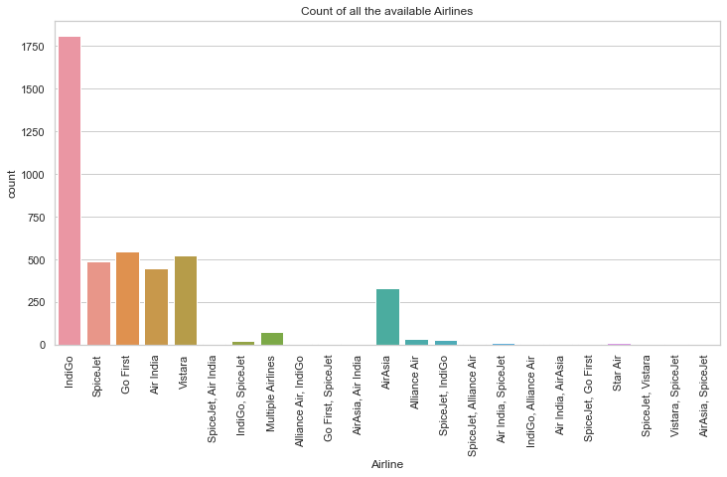
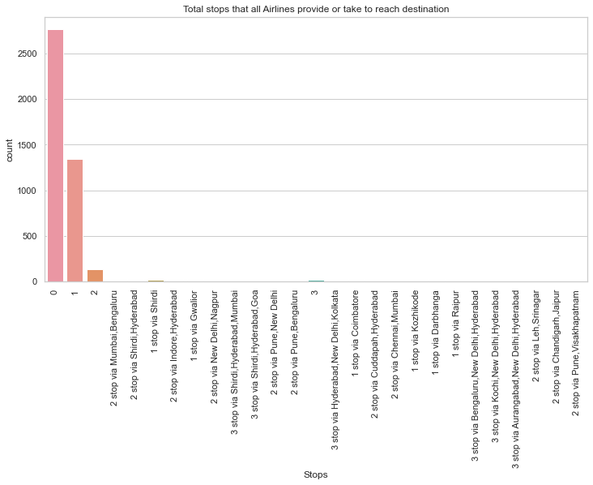
Numbers of airline companies and their flights:
Plot shows us the number of stops given by flights

Slide 12
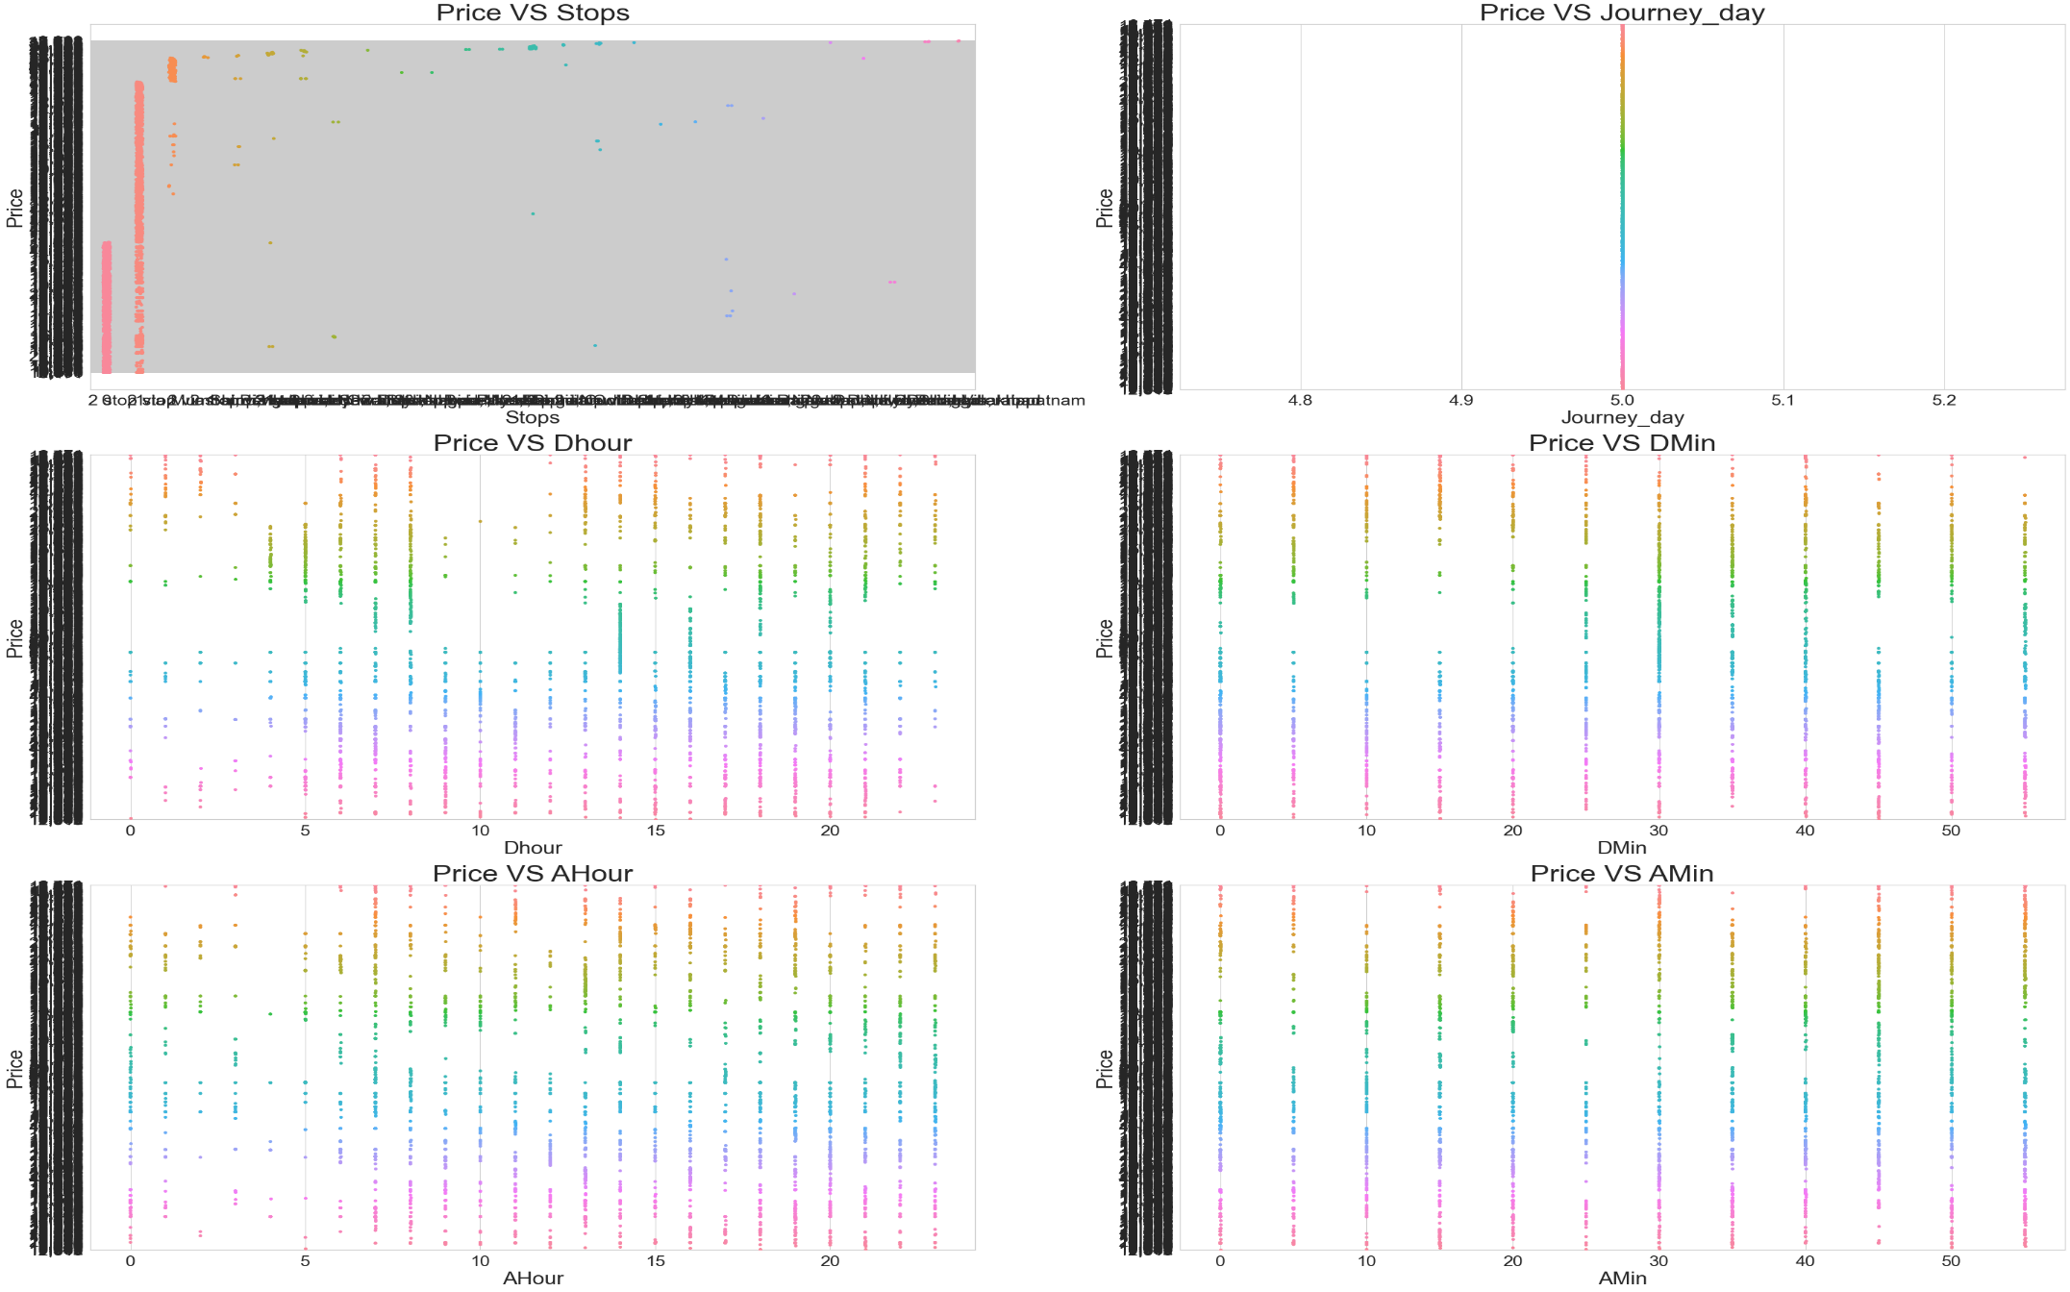
Bivariate Analysis:

Slide 13
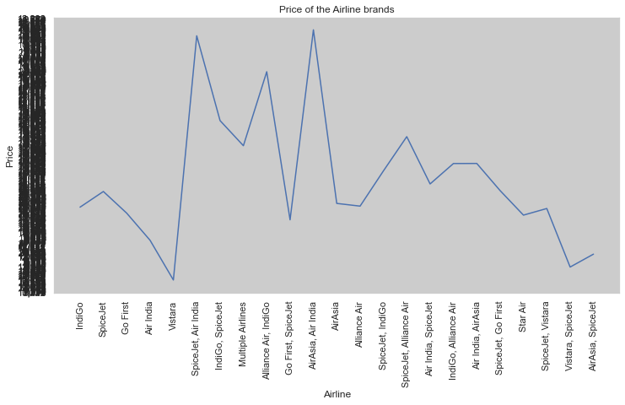
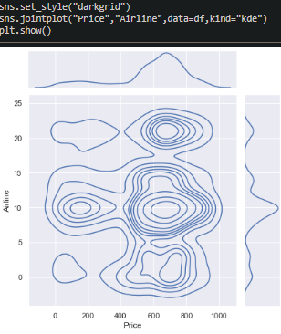
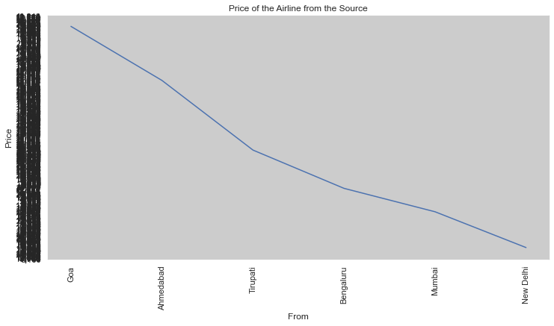
Price as per Airline Brand & source city:

Slide 14
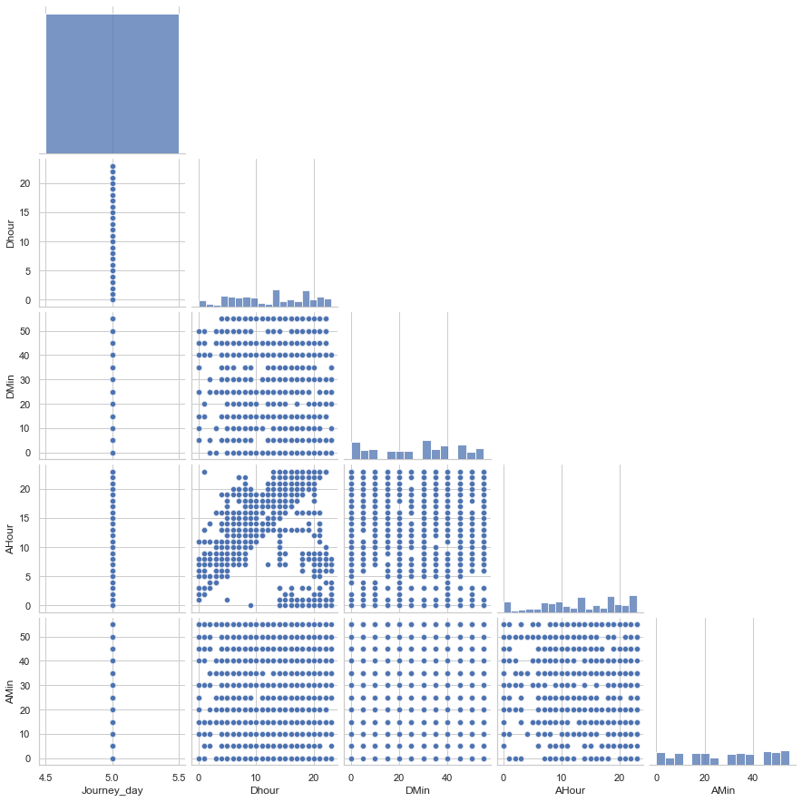
Multivariate Analysis: Pricing of flight per day, varies with time to time

Slide 15
Observations:
Univariate numerical columns:
There is no skewness in any of the numerical columns.
Univariate categorical columns:
Indigo has maximum count which means most of the passengers preferred Indigo for there travelling.
New Delhi has maximum count for source which means maximum passengers are choosing New Delhi as there source.
New Delhi has maximum count for Destination which means maximum passengers are choosing New Delhi as there Destination.
Flights with 2 stops costs more price compared to other flights.
In all the dates the price is almost same.
At 2PM departure time of every day the flight Prices are high so it looks good to book flights rather than this departure time.
And Departure minute has less relation with target Price.
At 7AM to 1PM Arrival time of every day the flight Prices are high so it looks good to book flights rather than this arrival time.
And Arrival minute has less relation with target Price.

Slide 16
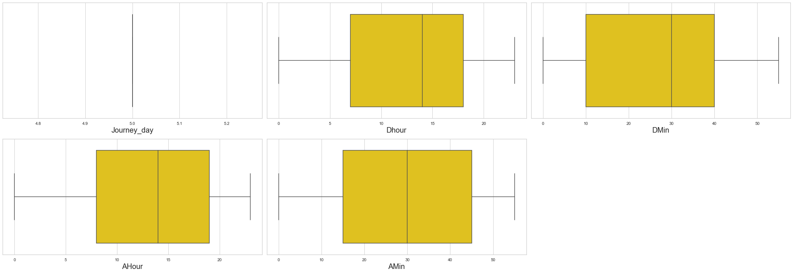
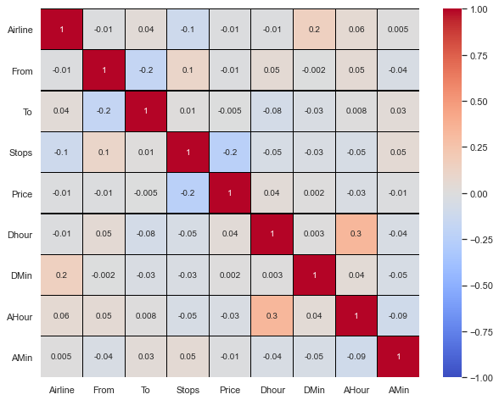
Checking for outliers:
Correlations of all the pair of features.To get better visualization on the correlation of features,let me plot it using heat map.
Heat map:

Slide 17
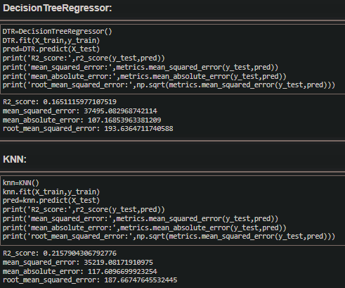
Model Building:
Important package required for Model building :
Our primary packages for this project are going to be pandas for data processing, NumPy to work with arrays, matplotlib & seaborn for data visualizations, and finally scikit-learn for building an evaluating our ML model.
RandomForestRegressor
XGBRegressor
ExtraTreesRegressor
GradientBoostingRegressor
DecisionTreeRegressor
KNN
BaggingRegressor

Slide 18
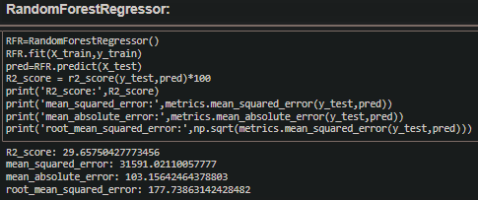
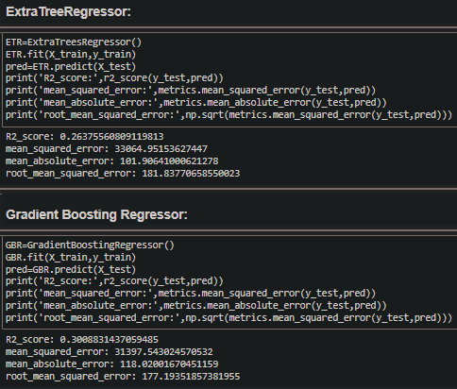
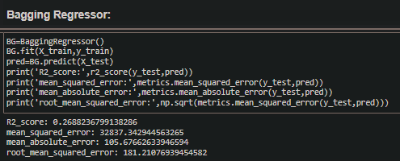
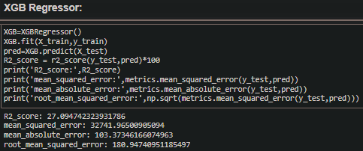

Slide 19
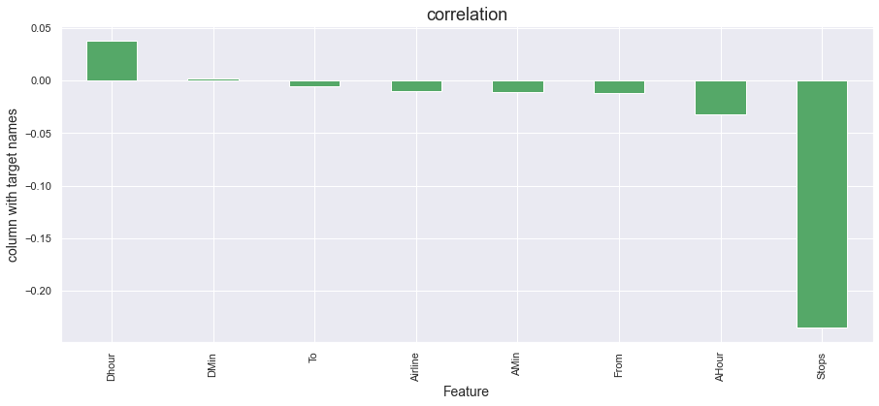
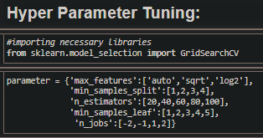
Correlation:
Using the sklearn.metrics I have calculated Adjusted R2 squared ,Mean Absolute Error (MAE),Mean Squared Error (MSE),Root Mean Squared Error (RMSE)
Using Hyper-parameter : model parameters are estimated from data automatically and model hyper-parameters are set manually and are used in processes to help estimate model and Grid search is a basic method for hyper-parameter tuning. It performs an exhaustive search on the hyper-parameter set specified by users.

Slide 20

Observations:
Maximum no. of flight as per company we see that Indigo has maximum flight count
Majority of flights have "Non-stop or one stop" and this shows that flights have reached directly to the destination with more amount of time for halt.
Business Class" has a lot of additional benefits. An Economy class doesn't have much benefits and hence people prefer this more as it's relatively cheaper.

Slide 21
Conclusion:
In this project report, we have used machine learning algorithms to predict the flight price. We have mentioned the step by step procedure to analyze the dataset and finding the correlation between the features.
Thus we can select the features which are correlated to each other and are independent in nature. The power of visualization has helped us in understanding the data by graphical representation it has made me to understand what data is trying to say.
A traveller can access this module to get the future price prediction of individual airlines. The prediction will help a traveller to decide a specific airline as per his/her budget.
Data cleaning is one of the most important steps to remove unrealistic values and unnecessary values.
These feature set were then given as an input to seven algorithms and a hyper parameter tunning was done to the best model and the accuracy has been improved. Hence we calculated the performance of each model using different performance metrics and compared them based on these metrics.
Then we have also saved the best model and predicted the flight price. It was good that the predicted and actual values were almost same.
To conclude, the application of machine learning in flight price prediction is still at an early stage. We hope this study has moved a small step ahead in providing some methodological and empirical contributions to online platforms, and presenting an alternative approach to the valuation of flight price.
Future direction of research may consider incorporating additional flight data from a larger economical background with more features.

Slide 22
